Slide 1
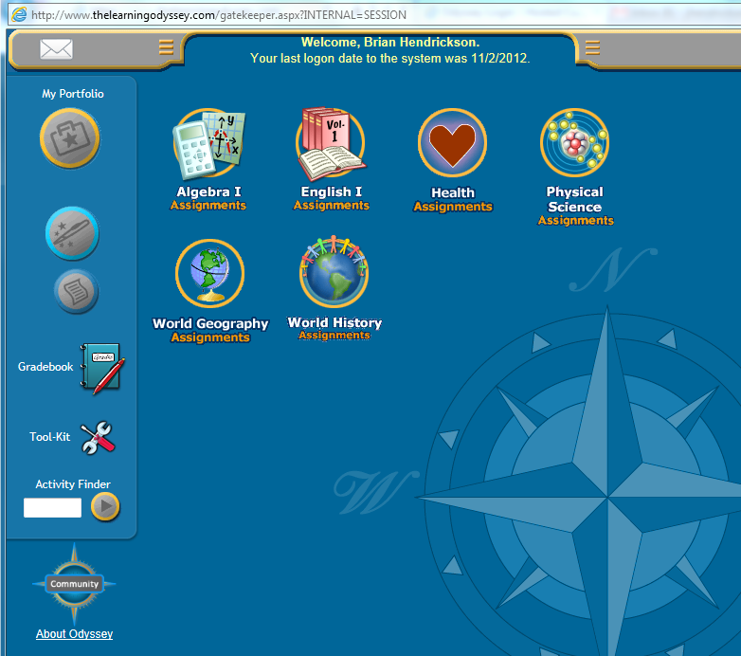
Using Activity Finder
1. Sign on as the Student
2. My Portfolio

Slide 2
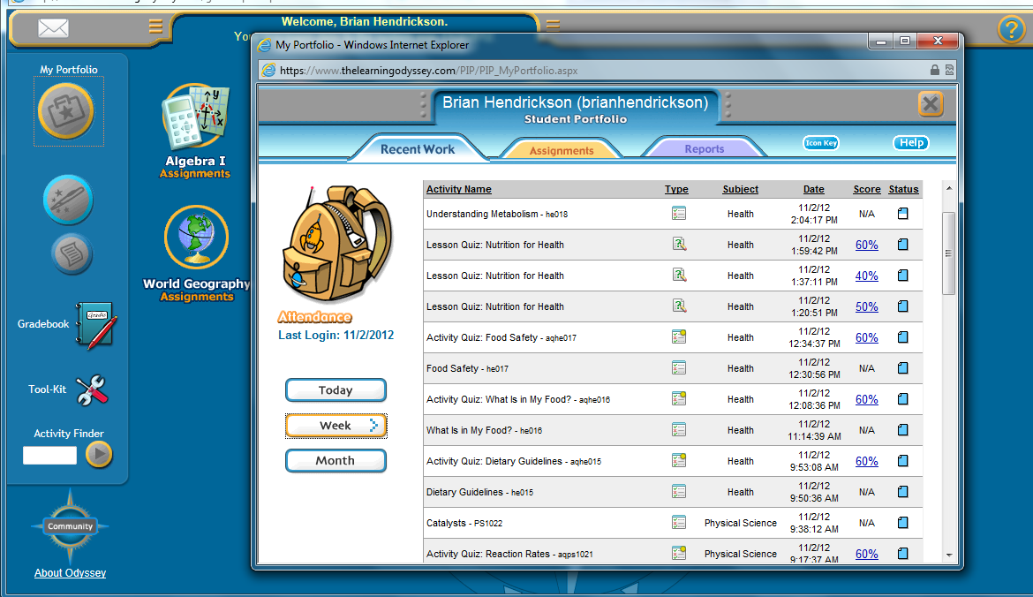
1. Click Week
2. Write down the lesson or Activity code
3. Close window

Slide 3
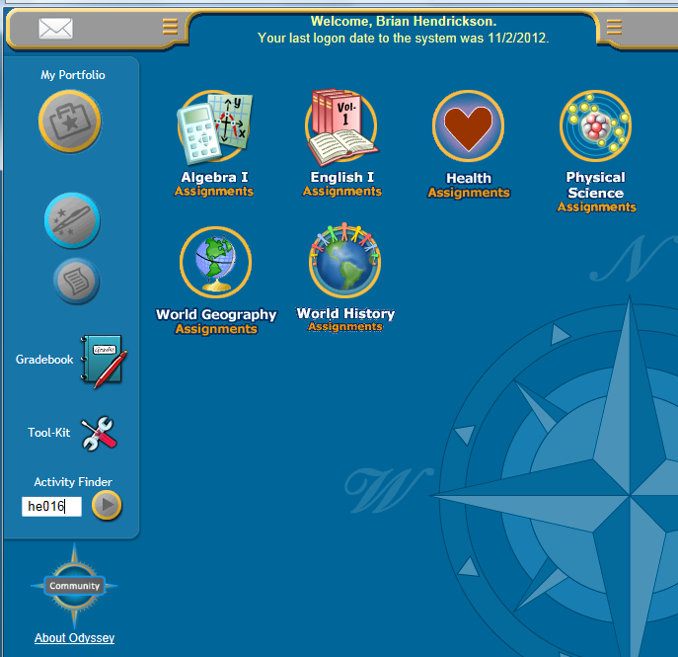
Enter Lesson or Activity Code in the Activity Finder
field
2. The Lesson or Activity Quiz will pop up automatically.

